Slide 1
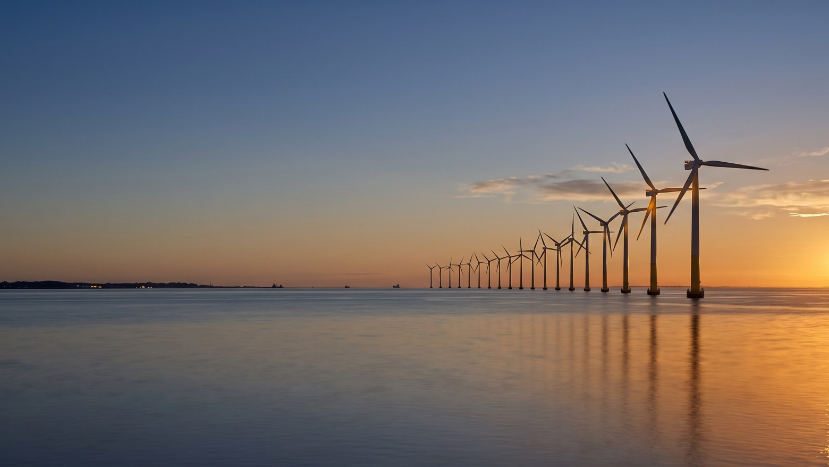
WEYLAND ENERGY
From steel to sea
Building the North Sea's next decade · Dr. Amara Okafor, CEO · North Sea Energy Summit, 22 September 2026
Notes:
Walk on, pause. 'Good morning Hamburg – it's nice to give a keynote and sleep in my own bed tonight.'

Slide 2
Weyland today
1.1 GW
4.2 GW
1.2 Mt
450
in operation
pipeline
CO₂ avoided in 2025
people
WEYLAND ENERGY · From steel to sea – keynote
2
Notes:
Keep it fast – the audience knows what a developer is.

Slide 3
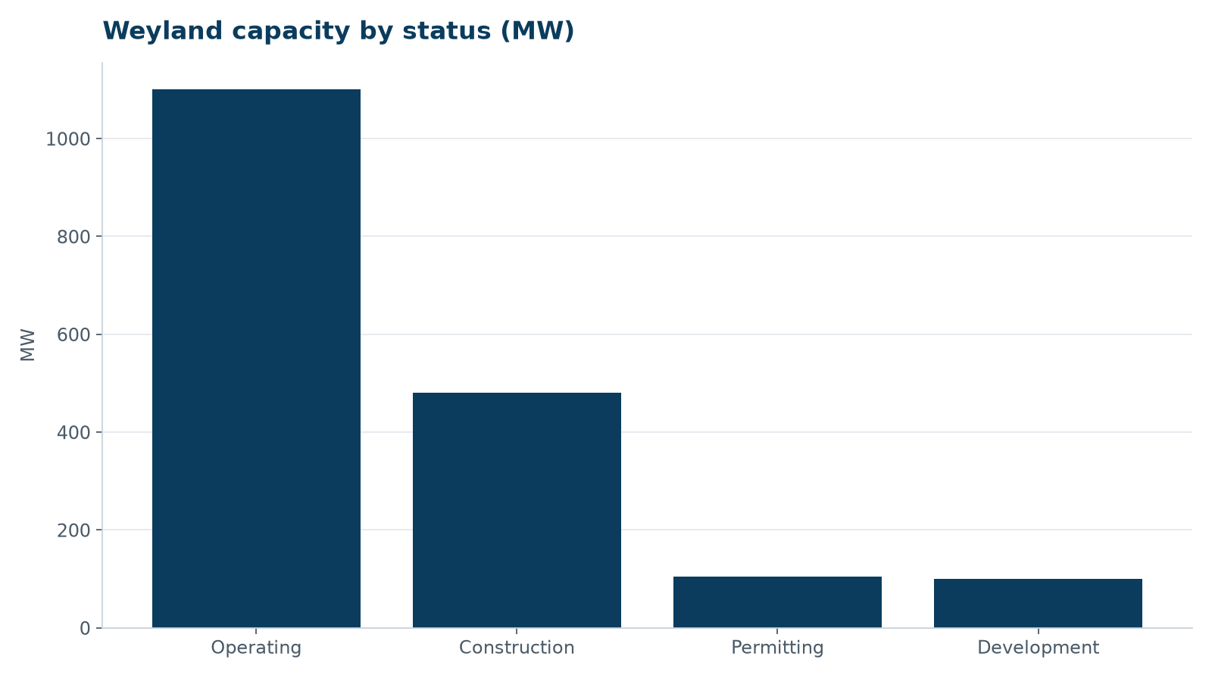
Our portfolio in one picture
• Harrow Bay – 480 MW offshore, in construction
• Kestrel Ridge – 97.4 % availability
• Millbrook – solar and storage, in planning
• Fenwick – 200 MWh battery
WEYLAND ENERGY · From steel to sea – keynote
3

Slide 4
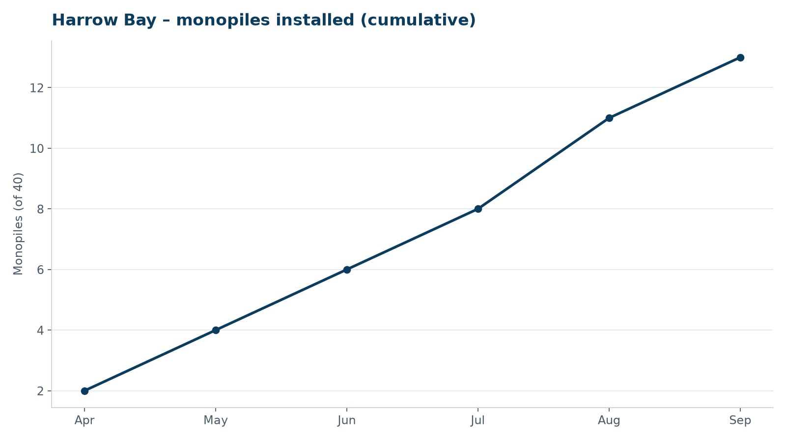
Harrow Bay is happening
• FID and EUR 1.1 bn financial close in February
• First monopile 7 April
• Substation topside 19 August
• 13 of 40 monopiles by mid-September
WEYLAND ENERGY · From steel to sea – keynote
4
Notes:
Say the number on the day – 13 installed on 22 September. Don't promise 20 by October.

Slide 5
Building is harder than planning
Three lessons from our first offshore year

Slide 6
Lesson 1: the supply chain is the project
• Fixed-price contracts for turbines, foundations, cables and vessel
• But: one factory test failure can move a cable by eight weeks
• We re-sequenced the campaign – COD 2028 unchanged
• Transparency with lenders and press from day one
WEYLAND ENERGY · From steel to sea – keynote
6
Notes:
This is the cable 2 story – mention it openly, it lands well. No supplier blame.

Slide 7
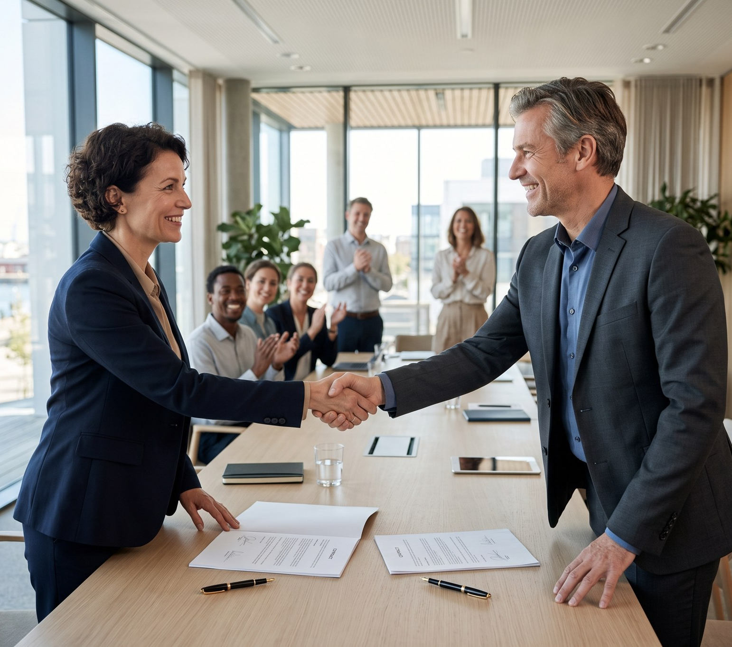
Lesson 2: green steel closes the loop
• 15-year PPA with Arcturus Steel – 150 MW, ~590 GWh a year
• Electrons from Harrow Bay into an electric arc furnace
• Next step: a 5 MW electrolyser at the Port of Eastholm
• Tomorrow's monopiles could be made of that steel
WEYLAND ENERGY · From steel to sea – keynote
7

Slide 8
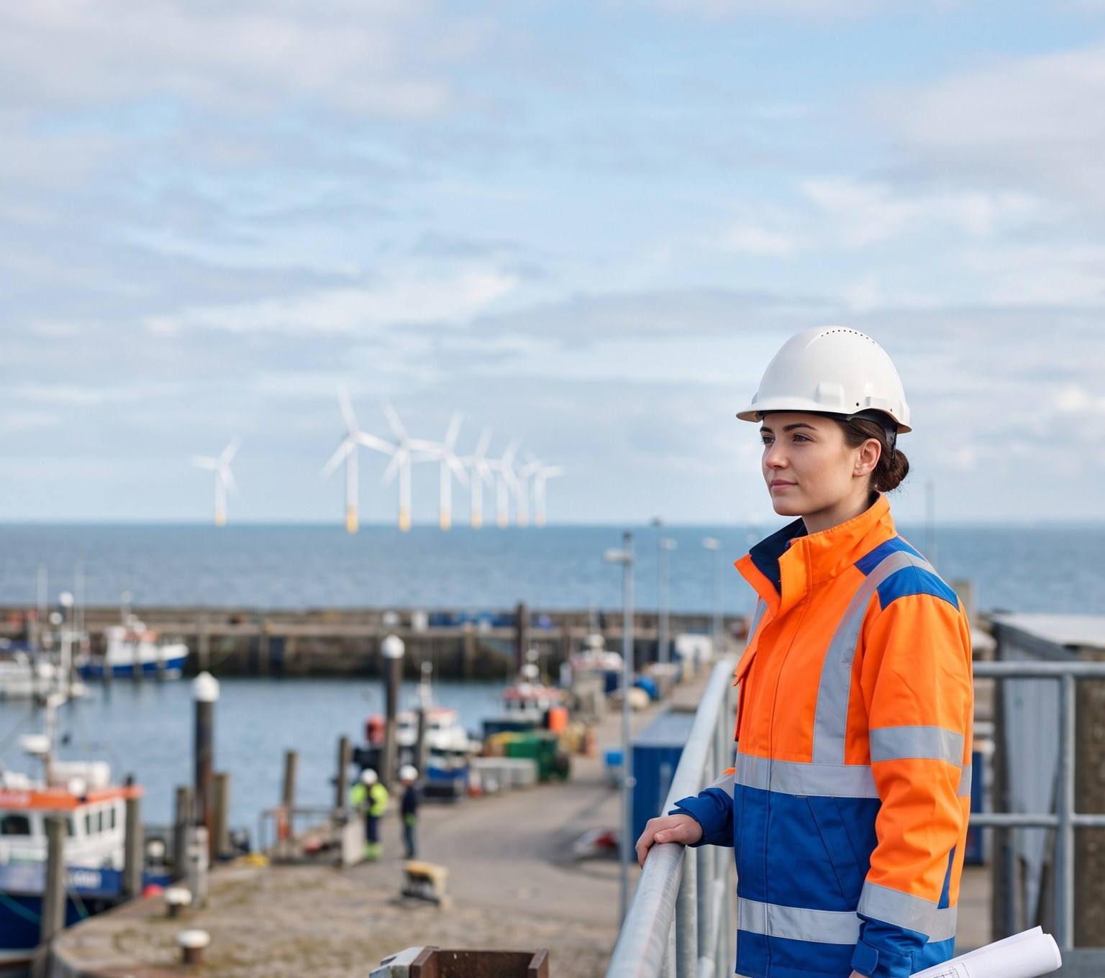
Lesson 3: people are the bottleneck
• 80 hires in 2026
• Powering the North: applications +66 %
• Apprentices at Kestrel Ridge
• Come and see us at B4.210
WEYLAND ENERGY · From steel to sea – keynote
8

Slide 9
Three asks
To | Ask
Governments | Faster grid connections – Fenwick waits until 2027 for an offer
Industry | Long-term offtake like Arcturus – PPAs make projects bankable
All of us | Train people now – a turbine without a technician is a monument
WEYLAND ENERGY · From steel to sea – keynote
9

Slide 10
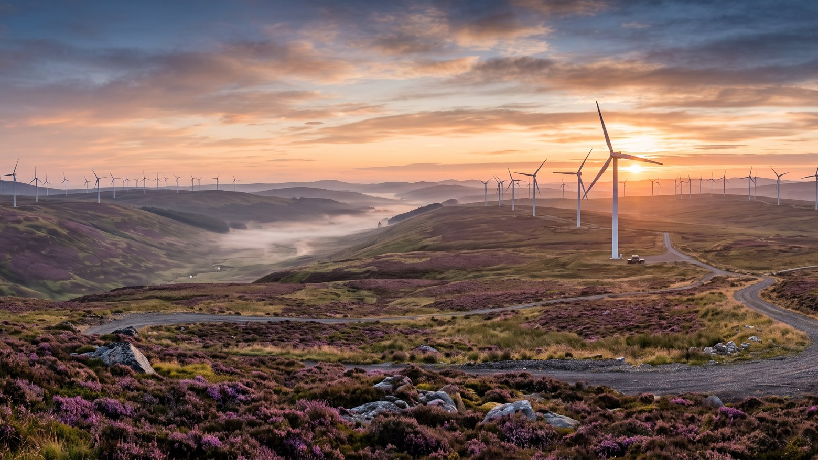
WEYLAND ENERGY
Clean power, built to last.
Booth B4.210 · weyland-energy.example

